Slide 1
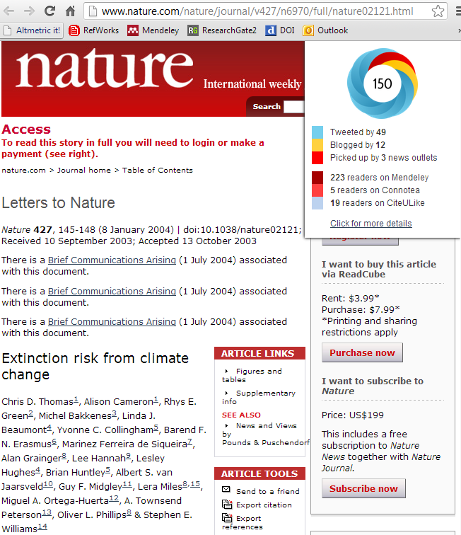
Using altmetrics to support research evaluation
Mike Thelwall
Statistical Cybermetrics & Research Evaluation Group
University of Wolverhampton, UK

Slide 2
Background: Citation Analysis
Academic research is published in many forms, including journal articles, books and reports.
The value of published research may be evaluated for jobs, grants and promotions.
Evaluators may assess the value of articles partly by the publishing journal or its citation count – the number other papers that have cited it.
Citation counts reflect scholarly impact but not societal impact, originality, or robustness.
Altmetrics complement citation counts.

Slide 3
What are Altmetrics?
Altmetrics – alternative metrics - are counts of mentions of academic outputs derived from the social web or elsewhere online.
E.g., the “Tweeter counts” altmetric assesses how many have tweeted an article.
👇 has a tweeter count of 31088 – huuuuuge!

Slide 4
Why Use Altmetrics for the Impact of Academic Publications?
Traditional citation counts don’t reflect:
💰 commercial value
🎨cultural impact
📚 educational use
⚖️ national influence in some countries and fields
And arrive slowly 🐌
Altmetrics can partially fill these gaps.
Do you assess researchers that try to have non-academic influence or value?

Slide 5
Examples of Standard Altmetrics
Educational impact: Online syllabus mentions or paper downloads
Public interest or engagement: Tweets, Blog citations, particularly for health topics
Cultural impact: Google Books citations?
Health impact: Health guideline citations
Commercial impact: patent citations
Early academic impact: Mendeley readers

Slide 6
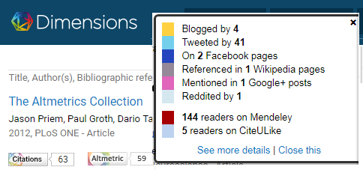
Data Sources
For small-scale evaluations, look up individual article altmetrics online.
Commercial indicator providers: Altmetric.com; Dimensions.ai; Plum Analytics (Elsevier)
For large-scale evaluations, automated collection from Altmetric.com with Webometric Analyst (free at: http://lexiurl.wlv.ac.uk) or buy data.

Slide 7
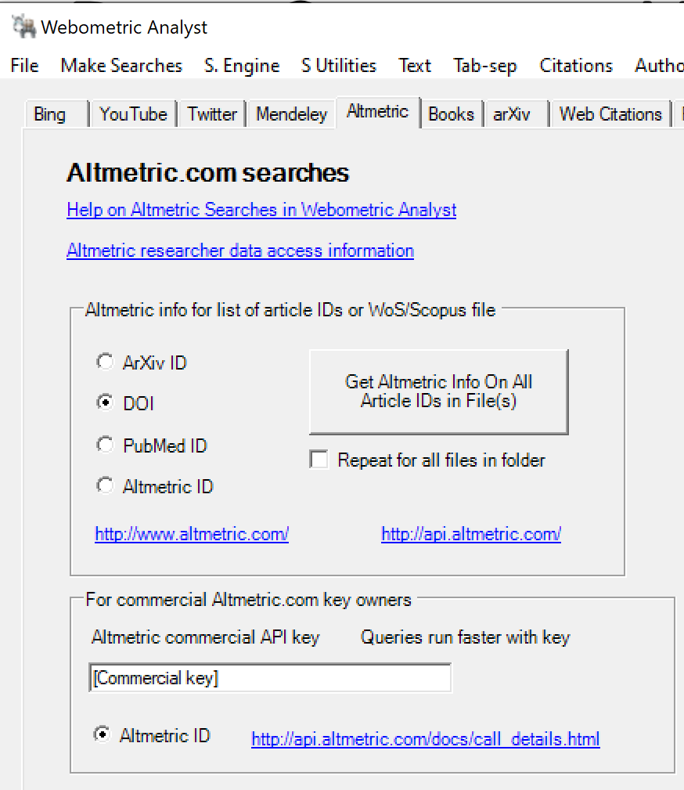
Data Sources: Webometric Analyst
Collects a set of altmetrics for your articles if you have a file with their DOIs.

Slide 8
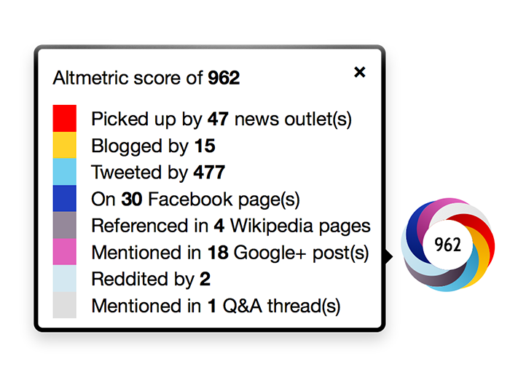
Data Sources: Altmetric.com
Convenient source of multiple indicators, many difficult to collect individually.
Gives data free for an article via its bookmarklet.
Also free via Dimensions.ai, with citation counts

Slide 9
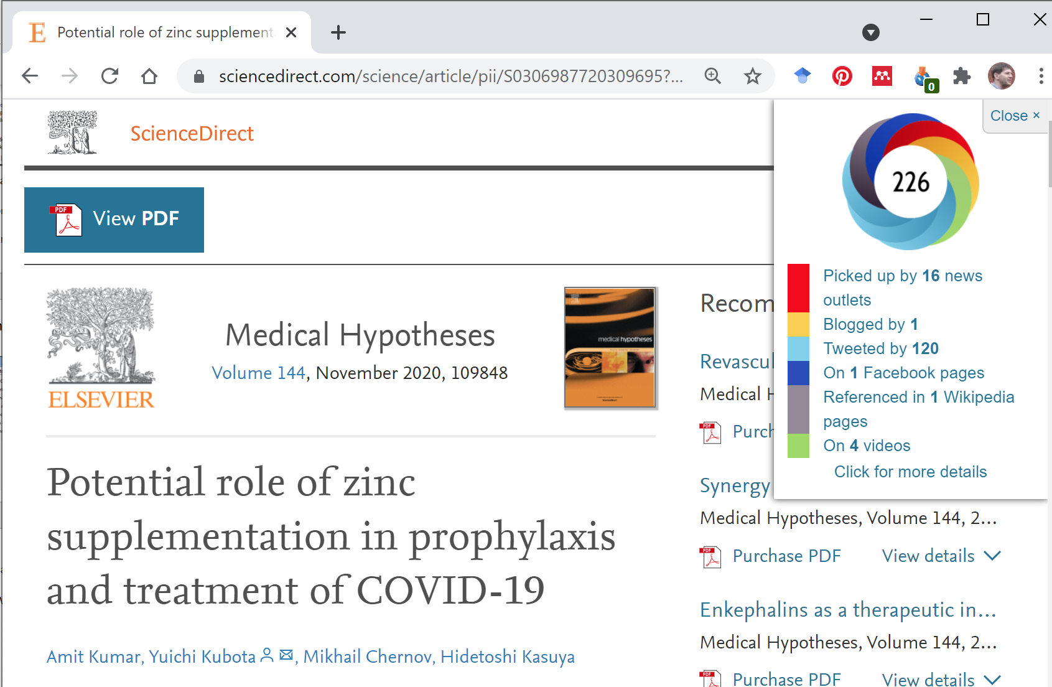

Slide 10
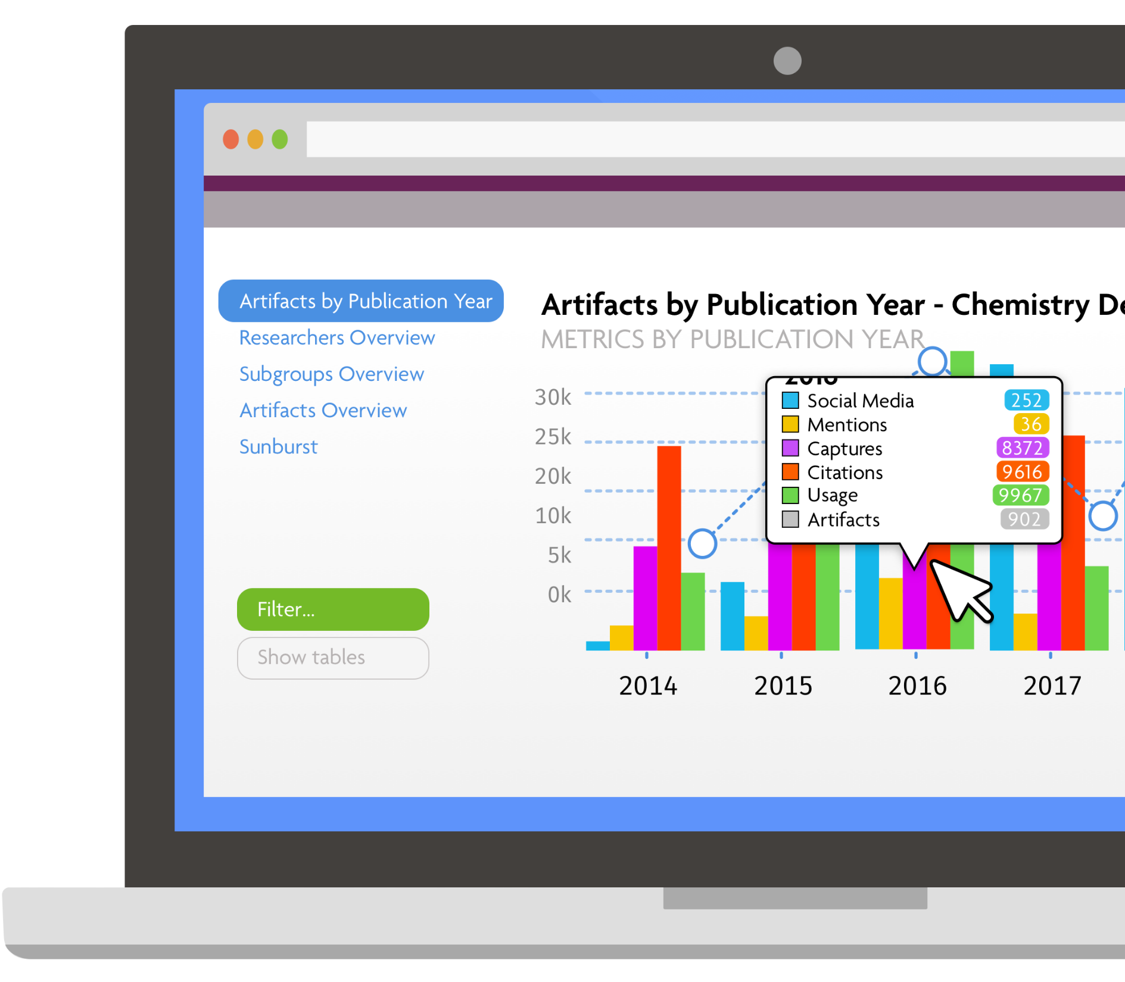
Data Sources: Plum Analytics
Packaged analyses
for institutions

Slide 11
Questions
Have you used any of these altmetric sources, or any others?
Did you find them useful and why?

Slide 12
Disadvantages of Alternative Indicators
Easy to manipulate
No quality control (e.g., on Twitter, Facebook)
Users often anonymous (& no evidence trail)
Easy to pay someone to inflate the numbers (except: F1000; web news media citations?)
Accidental manipulation happens
Viral tweets for articles with funny titles
Lecturers promoting their own works to their students
Reflect the actions of a biased subset of users
E.g., younger researchers are more likely to use social web sites

Slide 13
Evaluations of Altmetrics
Critical assessments of altmetrics have found limits to their value.
Common evaluation methods:
Face validity checks with content analysis (e.g., do tweets about research reflect public interests?)
Statistical checks with regression and correlation to assess whether altmetric scores reflect known types of impact.
Pragmatic checks to see if altmetric information helps decision making.

Slide 14
Mendeley Readers = Early scholarly impact
Mendeley readership counts correlate strongly (0.5-0.7: medicine, science) or moderately (0.3-0.5: social science & humanities) and positively with citations for articles in almost all research fields (Mohammadi, Thelwall, Haustein, & Larivière, 2015; Mohammadi & Thelwall, 2014; Thelwall, 2017; Zahedi, Costas, & Wouters, 2014)
Mendeley readers appear about a year before citations and are easy to collect (Thelwall, 2017)
They reflect mainly scholarly, partly educational impact.
Ehsan Mohammadi
Zohreh Zahedi

Slide 15
Mendeley Applications
Early evidence that TrendMD successfully publicises research by checking Mendeley reader counts for the promoted articles (Kudlow, et al., 2017)
Evidence that student readers are more common for one type of article than another – e.g., female authored articles attract more student readers than male authored articles (Thelwall, 2018b).

Slide 16
Tweets = 50% academic interest and publicity; 50% broader interest
Tweet counts often have very low positive correlations with citation counts and downloads (Haustein, et al., 2014; Thelwall, Haustein, Larivière, & Sugimoto, 2013; Shuai, Pepe, & Bollen, 2012)
Article tweets are typically just titles or highlights and links (Thelwall, Tsou, Weingart, Holmberg, & Haustein, 2013)
Half of all tweeted links to journal articles are from non-academics (Mohammadi et al., 2018).
Notes:
The association was assessed with a purpose-built statistical test, the sign test (Thelwall, Haustein, Larivière, & Sugimoto, 2013).

Slide 17
Discussion/Social Impacts
Some social web indicators seem to reflect a degree of academic and public interest but are too rare to be used to evaluate typical articles:
Facebook wall posts, Google+, Reddit, Pinners, LinkedIn (Thelwall, Haustein, Larivière, & Sugimoto, 2013; see also: Costas, Zahedi, & Wouters, 2014; Zahedi, Costas, & Wouters, 2014)
Also blogs (Shema, Bar‐Ilan, & Thelwall, 2014)
Altmetric.com data

Slide 18
Health Impacts
Health indicators indicate genuine and specific impact but are available for few articles:
F1000 judge ratings probably reflect the value of biomedical research – they also correlate significantly and positively with citations (Bornmann & Leydesdorff, 2013; Li & Thelwall, 2012; Mohammadi & Thelwall, 2013; Waltman & Costas, 2014; see also: Wouters & Costas, 2012), but not for ecology articles (Wardle, 2010)
Citations in NICE clinical guidelines reflect important contributions to UK health practice – they also correlate with academic citations (Thelwall & Maflahi, 2016)

Slide 19
Cultural Impacts
Several indicators are particularly suitable for arts and humanities research and partly reflect cultural impacts – but are difficult to gather.
Google Books citations (Kousha & Thelwall, 2015)
Worldcat.org library holdings (White, Boell, et al. 2009)
Amazon book reviews (Kousha & Thelwall, 2016)
Kayvan Kousha

Slide 20
regression
Do altmetrics predict future citations?
2015 2016 2017
Altmetric.com scores
Scopus citations
Publications assessed

Slide 21
Linear regression results
For 29 out of 30 fields, 2015 Altmetric.com data significantly predicted 2017 Scopus citation counts.
Mendeley reader counts always a statistically significant predictor.
Other indicators sometimes statistically significant predictors (never: Connotea, F1000).
Altmetric.com scores from 2015 “explain” about 20% of citation scores from 2017.
Altmetric.com scores
Scopus citations
2015 2016 2017

Slide 22
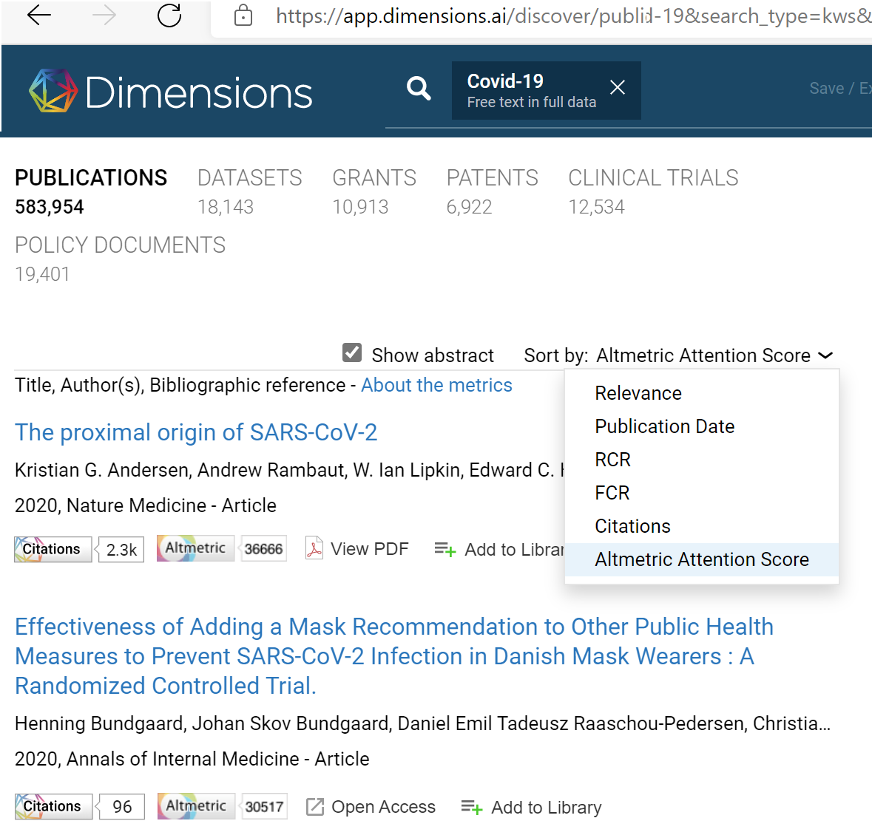
Task ☺ Go to dimensions.ai, search for documents, filter to this year, and sort by Altmetric Attention Score to see high attention articles this year in your area!

Slide 23
2. Alternative Indicators in Research Evaluations of Research Groups or Funders
Choose relevant alternative indicators
Need to field normalise in order to allow fair comparisons
Because some fields cite a lot more than others (longer reference lists, shorter publication delays)
Need to year normalise in order to allow fair comparisons
Because older articles have had longer to attract citations and mentions

Slide 24
Field normalised indicators
MNLCS (Mean Normalised Log-transformed Citation Scores) for Mendeley readers (or citations, tweets…)
Citation rate compared to world average for the field and year
Not affected by skewed citation/altmetric counts
Produce a single number, where > 1 signifies above world average
$c_{i}:s$cores of papers produced by group
$l_{i}:$ corresponding field and year world average scores

Slide 25
Example: Scopus citations comparing funders
Citation confidence intervals are
too wide for recent years
to compare funders
Data from June 2016.
Thelwall, M. (2017). Three practical field normalised alternative indicator formulae
for research evaluation. Journal of Informetrics, 11(1), 128–151.

Slide 26
Example: Mendeley readers comparing funders
Mendeley confidence intervals are
narrower for recent years,
allowing a conclusion that one
has more average impact than another

Slide 27
3: Pandemic Food Security Evaluation: Food and Agricultural Organisation of the UN
Evaluation of FAO’s Pandemic-Related Contributions to Policy, Programmes and Knowledge
A component of the full analysis from FAO’s evaluation team
https://www.fao.org/evaluation/highlights/highlights-detail/en/c/1445582/

Slide 28
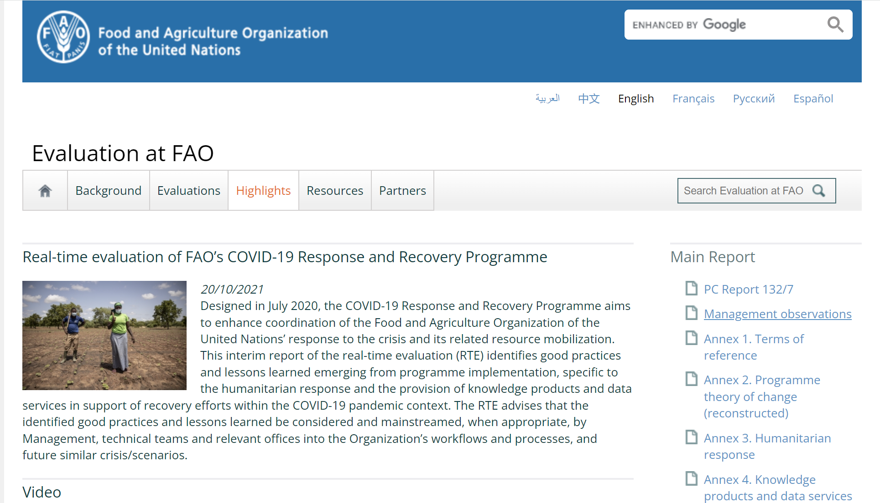

Slide 29
What did we do?
Count online mentions of FAO online Covid-19 knowledge products (FAO Covid-19 website and food databases) and selected reports (e.g., “Agri-food markets and trade policy in the time of COVID-19”).
Manually checked random samples of mentions for context.
Summarised how FAO knowledge products or reports were mentioned.
Evaluated pandemic mentions of FAO on Twitter compared to similar organisations.

Slide 30
Example of Online Influence Evidence
FAO warned of crop scarcity and Indonesian government took action, "Although the disruption to food and agricultural production has not yet been seen clearly at the field level, the Food and Agriculture Organization (FAO) on its official website dated March 30, 2020, reminded. In response to this warning, President Joko Widodo in a limited meeting through a virtual conference with vice president Ma'ruf Amin and advanced Indonesian cabinet ministers instructed to ensure the availability of basic commodities and rice production is carefully calculated and calculated completely based on valid and reliable empirical data (Cabinet Secretariat of the Republic of Indonesia, 2020).” (Identified with Google; document in Indonesian)

Slide 31
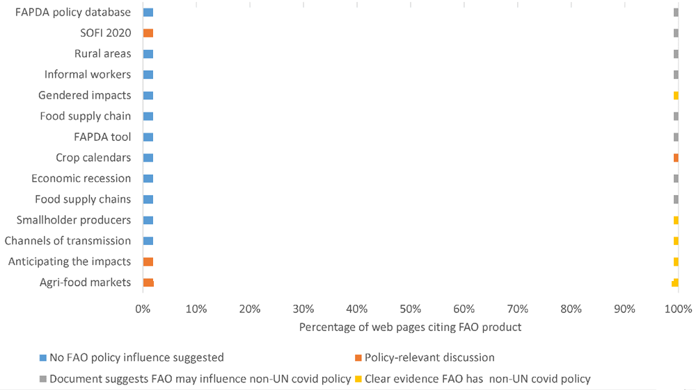
Example Output: Influence per FAO report
Graph shows the percentage of websites mentioning FAO reports that related to policy in different ways [values redacted]
FAO Covid-19 Knowledge Product

Slide 32
Question
Is there any type of online evidence of the influence or impact of the researchers you are assessing?
Could you find it systematically with Google searches and count or list it?

Slide 33
4. Alternative Indicators in Research Evaluations of Non-Academic Impacts: NESTA, UNDP, FAO
Some organisations produce non-academic research & need impact evaluation
Think tanks, government departments, NGOs
Target audience not academic
WoS/Scopus citations irrelevant (and almost non-existent)
May use LexisNexis media mentions
Web mentions an alternative source

Slide 34
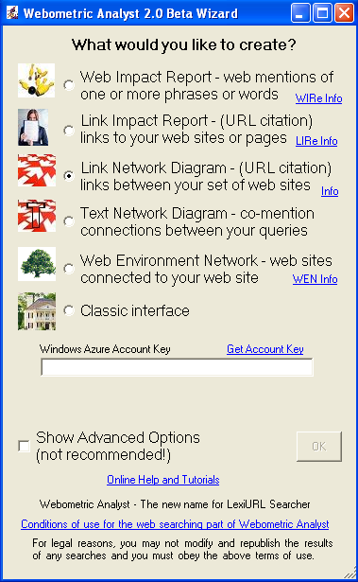
Web citation analysis
Count mentions of report on the web
Evidence of wider public and media interest
Could focus on just blogs
Can be automated (Webometric Analyst)
Lots of Spam
Need manual checking and content analysis for the best results (expensive)

Slide 35
NESTA Web Reports
National Endowment for Science, Technology and the Arts
Conducted twice-yearly for several years
Evaluate the online impact of the most recent 20 reports because scholarly impact not relevant
Identify successful and unsuccessful reports
Identify successful and unsuccessful types of report

Slide 36
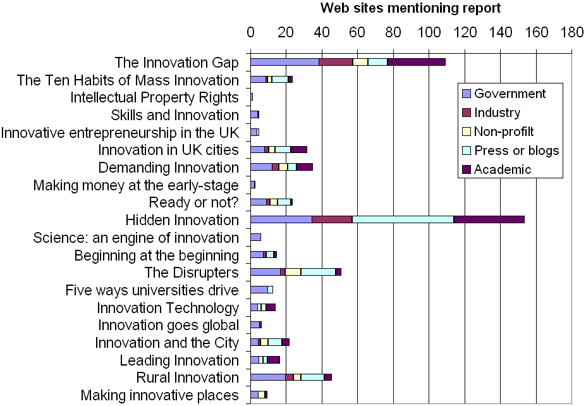

Slide 37
NESTA Research Citation Index
Citing document title and information | Type | Cited NESTA document
Legitimising RTI-policy: Market failure and systems failure - Two sides of one coin? - and beyond, Paper presented at the EAEPE Conference, Porto, 1-3 November 2007, Klaus Kubeczko & Matthias Weber | Conference paper | Demanding Innovation
Public procurement and innovation - Resurrecting the demand side, Edler J, Georghiou L, (2007). Research Policy, 36(7), 949-963. | Journal article | Demanding Innovation
Innovation Nation, DIUS, March 2009 | Research Report | Demanding Innovation
A simple list of the webpages citing key Nesta documents

Slide 38
Summary
Alternative indicators useful for early evidence of impact and (weak) evidence of some non-academic impacts.
Mendeley useful for early scholarly impact evaluations
Always limited in scope, biased & probably not removing national biases in Scopus/WoS.
Can’t be used for formal evaluations when stakeholders know in advance.
Suitable for self-monitoring.
Get online from Dimensions.ai or buy access to analytic toolkit from Dimensions.ai or Elsevier.

Slide 39
Bibliography/References –email Mike Thelwall for a copy of the slides with references
Adie, E., & Roe, W. (2013). Altmetric: enriching scholarly content with article-level discussion and metrics. Learned Publishing, 26(1), 11-17.
Bar-Ilan, J. (2012). JASIST@mendeley. In ACM Web Science Conference 2012 Workshop. http://altmetrics.org/altmetrics12/bar-ilan/
Bornmann, L., & Leydesdorff, L. (2013). The validation of (advanced) bibliometric indicators through peer assessments: A comparative study using data from InCites and F1000. Journal of Informetrics, 7(2), 286-291.
Borrego, Á., & Fry, J. (2012). Measuring researchers’ use of scholarly information through social bookmarking data: A case study of BibSonomy. Journal of Information Science, 38(3), 297-308.
Costas, R., Zahedi, Z., & Wouters, P. (2014). Do altmetrics correlate with citations? Extensive comparison of altmetric indicators with citations from a multidisciplinary perspective. arXiv preprint arXiv:1401.4321.
Eysenbach, G. (2011). Can tweets predict citations? Metrics of social impact based on Twitter and correlation with traditional metrics of scientific impact. Journal of Medical Internet Research, 13(4), e123.
Haustein, S., Larivière, V., Thelwall, M., Amyot, D., & Peters, I. (2014). Tweets vs. Mendeley readers: How do these two social media metrics differ?. IT-Information Technology, 56(5), 207-215..
Haustein, S., & Siebenlist, T. (2011). Applying social bookmarking data to evaluate journal usage. Journal of Informetrics, 5(3), 446-457.
Henning, V., & Reichelt, J. (2008). Mendeley - A Last.fm for research? In. IEEE Fourth International Conference on eScience. (eScience'08) (pp. 327-328). Menlo Park: IEEE.
Kousha, K, Thelwall, M. & Abdoli, M. (2018). Can Microsoft Academic assess the early citation impact of in-press articles? A multi-discipline exploratory analysis. Journal of Informetrics, 12(1), 287-298.
Kousha, K. & Thelwall, M. (2007). Google Scholar citations and Google Web/URL citations: A multi‐discipline exploratory analysis. Journal of the American Society for Information Science and Technology, 58(7), 1055-1065.
Kousha, K. & Thelwall, M. (2008). Assessing the impact of disciplinary research on teaching: An automatic analysis of online syllabuses, Journal of the American Society for Information Science and Technology, 59(13), 2060-2069.
Kousha, K. & Thelwall, M. (2007). Google Scholar citations and Google Web/URL citations: A multi-discipline exploratory analysis, Journal of the American Society for Information Science and Technology, 57(6), 1055-1065.
Kousha, K. & Thelwall, M. (2015). An automatic method for extracting citations from Google Books. Journal of the Association for Information Science and Technology, 66(2), 309–320.
Kousha, K. & Thelwall, M. (2016). Can Amazon.com reviews help to assess the wider impacts of books? Journal of the Association for Information Science and Technology, 67(3), 566-581.
Kraker, P., Schlögl, C., Jack, K., & Lindstaedt, S. (2014). Visualization of co-readership patterns from an online reference management system. arXiv preprint arXiv:1409.0348.
Kudlow, P., Cockerill, M., Toccalino, D., Dziadyk, D. B., Rutledge, A., Shachak, A., ... & Eysenbach, G. (2017). Online distribution channel increases article usage on Mendeley: a randomized controlled trial. Scientometrics, 112(3), 1537-1556.
Li, X., Thelwall, M., & Giustini, D. (2012). Validating online reference managers for scholarly impact measurement. Scientometrics, 91(2), 461-471.
Li, X., & Thelwall, M. (2012). F1000, Mendeley and traditional bibliometric indicators. In Proceedings of the 17th International Conference on Science and Technology Indicators (Vol. 2, pp. 451-551).
Maflahi, N. & Thelwall, M. (2016). When are readership counts as useful as citation counts? Scopus versus Mendeley for LIS journals. Journal of the Association for Information Science and Technology, 67(1), 191-199..
Mohammadi, E., Thelwall, M., Kwasny, M., & Holmes, K. L. (2018). Academic information on Twitter: A user survey. PloS one, 13(5), e0197265.
Mohammadi, E., Thelwall, M., Haustein, S., & Larivière, V. (2015). Who reads research articles? An altmetrics analysis of Mendeley user categories. Journal of the Association for Information Science and Technology , 66(9), 1832-1846
Mohammadi, E., & Thelwall, M. (2013). Assessing non-standard article impact using F1000 labels. Scientometrics, 97(2), 383-395.
Mohammadi, E. & Thelwall, M. (2014). Mendeley readership altmetrics for the social sciences and humanities: Research evaluation and knowledge flows. Journal of the Association for Information Science and Technology, 65(8), 1627-1638.
Mohammadi, E., (2014). Identifying the invisible impact of scholarly publications: A multi-disciplinary analysis using altmetrics. Wolverhampton, UK: University of Wolverhampton.
Piwowar, H., & Priem, J. (2013). The power of altmetrics on a CV. Bulletin of the American Society for Information Science and Technology, 39(4), 10-13.
Priem, J., Piwowar, H. A., & Hemminger, B. M. (2012). Altmetrics in the wild: Using social media to explore scholarly impact. arXiv preprint arXiv:1203.4745.
Priem, J., Taraborelli, D., Groth, P., & Neylon, C. (2010). Altmetrics: A manifesto. http://altmetrics.org/manifesto/
Shema, H., Bar-Ilan, J., & Thelwall, M. (2012). Research blogs and the discussion of scholarly information. PloS ONE, 7(5), e35869.
Shema, H., Bar‐Ilan, J., & Thelwall, M. (2014). Do blog citations correlate with a higher number of future citations? Research blogs as a potential source for alternative metrics. Journal of the Association for Information Science and Technology, 65(5), 1018-1027.
Shuai, X., Pepe, A., & Bollen, J. (2012). How the scientific community reacts to newly submitted preprints: Article downloads, Twitter mentions, and citations. PloS ONE, 7(11), e47523.
Sud, P. & Thelwall, M. (2014). Evaluating altmetrics. Scientometrics, 98(2), 1131-1143.
Thelwall, M. & Cugelman, B. (2017). Monitoring Twitter strategies to discover resonating topics: the case of the UNDP. El Profesional de la Información, 26(4), 649-661.
Thelwall, M., Haustein, S., Larivière, V. & Sugimoto, C. (2013). Do altmetrics work? Twitter and ten other candidates. PLOS ONE, 8(5), e64841. doi:10.1371/journal.pone.0064841
Thelwall, M., Kousha, K., Dinsmore, A. & Dolby, K. (2016). Alternative metric indicators for funding scheme evaluations. Aslib Journal of Information Management, 68(1), 2-18. doi:10.1108/AJIM-09-2015-0146
Thelwall, M., & Kousha, K. (2017). ResearchGate versus Google Scholar: Which finds more early citations? Scientometrics, 112(2), 1125-1131
Thelwall, M. & Maflahi, N. (2015). Are scholarly articles disproportionately read in their own country? An analysis of Mendeley readers. Journal of the Association for Information Science and Technology, 66(6), 1124–1135
Thelwall, M. & Maflahi, N. (2016). Guideline references and academic citations as evidence of the clinical value of health research. Journal of the Association for Information Science and Technology , 67(4), 960-96
Thelwall, M., Tsou, A., Weingart, S., Holmberg, K., & Haustein, S. (2013). Tweeting links to academic articles. Cybermetrics: International Journal of Scientometrics, Informetrics and Bibliometrics, 17(1), paper 1.
Thelwall, M. & Wilson, P. (2016). Mendeley readership Altmetrics for medical articles: An analysis of 45 fields, Journal of the Association for Information Science and Technology 67(8), 1962-1972. doi:10.1002/asi.23501
Thelwall, M. (2017). Web indicators for research evaluation: A practical guide. San Rafael, CA: Morgan & Claypool.
Thelwall, M. (2017). Three practical field normalised alternative indicator formulae for research evaluation. Journal of Informetrics, 11(1), 128–151.
Thelwall, M., (2018). Does Microsoft Academic find early citations? Scientometrics, 114:325–334.. doi:10.1007/s11192-017-2558-9
Thelwall, M. (2017). Are Mendeley reader counts high enough for research evaluations when articles are published? Aslib Journal of Information Management, 69(2), 174-183. doi:10.1108/AJIM-01-2017-0028
Thelwall, M. (2017). Are Mendeley reader counts useful impact indicators in all fields? Scientometrics, 113(3), 1721–1731.
Thelwall, M. (2018). Dimensions: A competitor to Scopus and the Web of Science? Journal of Informetrics, 12(2), 430–435.
Thelwall, M. (2018b). Does female-authored research have more educational impact than male-authored research? Journal of Altmetrics. 1(1), p.3.
Tijssen, R. J. W., Buter, R. K., & Van Leeuwen, T. N. (2000). Technological relevance of science: An assessment of citation linkages between patents and research papers. Scientometrics, 47(2), 389-412.
Vaughan, L., & Shaw, D. (2003). Bibliographic and web citations: what is the difference? Journal of the American Society for Information Science and Technology, 54(14), 1313-1322.
Waltman, L., & Costas, R. (2014). F1000 Recommendations as a potential new data source for research evaluation: a comparison with citations. Journal of the Association for Information Science and Technology, 65(3), 433-445.
Wardle, D. A. (2010). Do 'Faculty of 1000' (F1000) ratings of ecological publications serve as reasonable predictors of their future impact? Ideas in Ecology and Evolution, 3(1), 11-15.
White, H. D., Boell, S. K., Yu, H., Davis, M., Wilson, C. S., & Cole, F. T. (2009). Libcitations: A measure for comparative assessment of book publications in the humanities and social sciences. Journal of the American Society for Information Science and Technology, 60(6), 1083-1096.
Wilkinson, D., Sud, P., & Thelwall, M. (2014). Substance without citation: Evaluating the online impact of grey literature. Scientometrics, 98(2), 797-806.
Wouters, P., & Costas, R. (2012). Users, narcissism and control: tracking the impact of scholarly publications in the 21st century. Proceedings of the 17th International Conference on Science and Technology Indicators (Vol. 2, pp. 487-497).
Zahedi, Z., Costas, R., & Wouters, P. F. (2013). What is the impact of the publications read by the different Mendeley users? Could they help to identify alternative types of impact?. PLoS ALM Workshop. https://openaccess.leidenuniv.nl/handle/1887/23579
Zahedi, Z., Costas, R., & Wouters, P. (2014). How well developed are altmetrics? A cross-disciplinary analysis of the presence of ‘alternative metrics’ in scientific publications. Scientometrics, 101(2), 1491-1513.

Slide 40
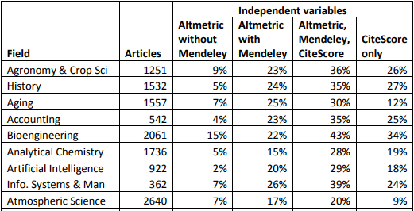
Altmetric.com & CiteScore regression Percentage of variance explained ($R^{2}$)
The optimal combination of data to predict future citation counts is CiteScore and Altmetric.com data
R²

